Slide 1
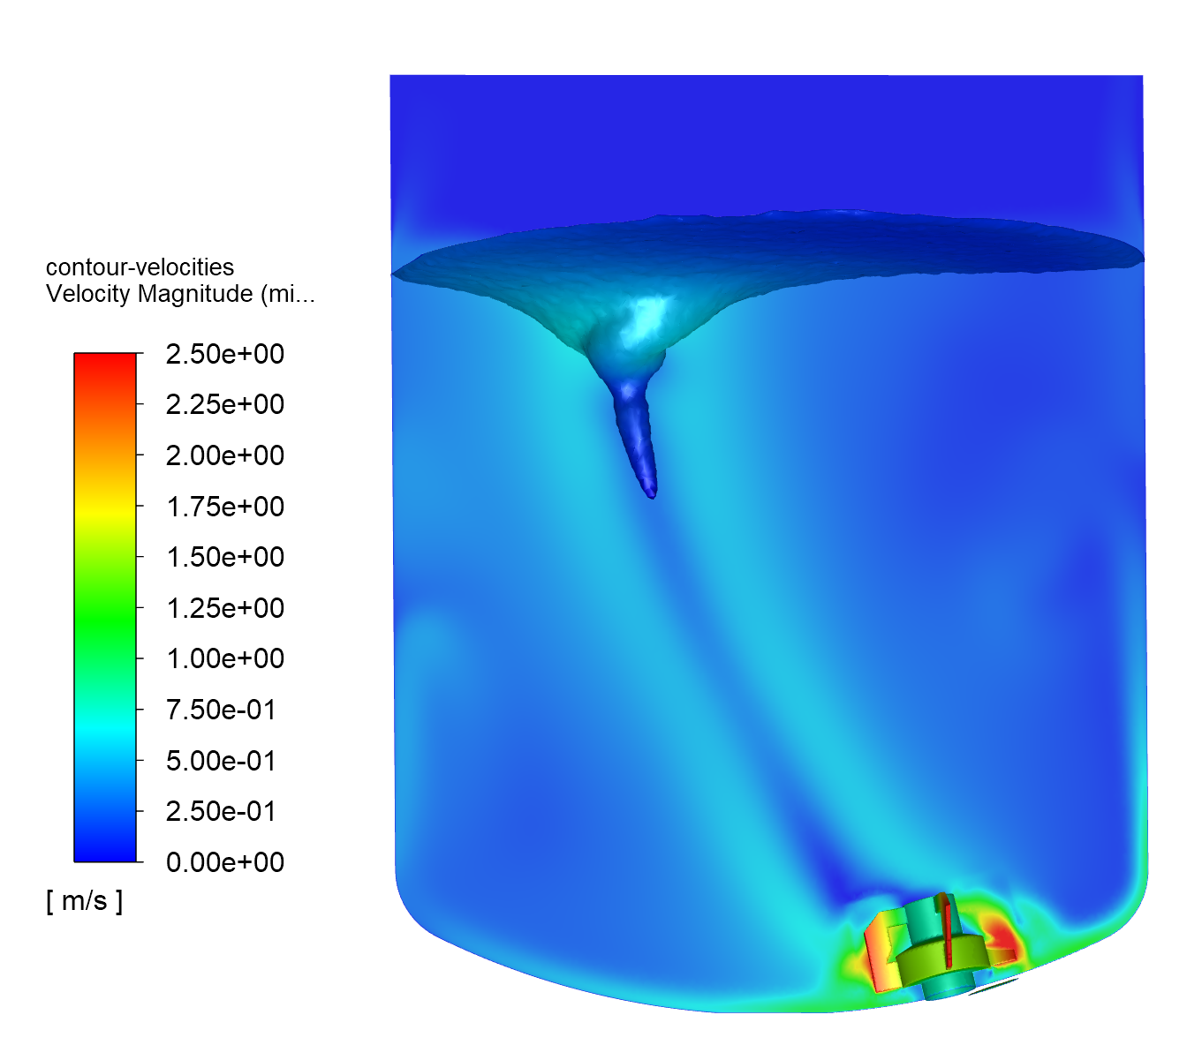
CFD SIMULATIONS
FOR TANK MIXING PROCESS

Slide 2
MIXING PROBLEMS
Mixing in tanks/reactors is a very important process for the pharmaceutical and F&B industries.
Even it looks to be simple and easy manageable, it hides a lot of traps and leads to a high number of failures and issues like:
Nonhomogeneous suspensions/emulsions
High mixing/heating times
Foaming
Cells damaging (for bioreactors)
Mixing problems at low liquid levels
Process transfer/upscale failures
Under/oversize motor power
Overheating of sensitive/EX products
CFD SIMULATIONS
FOR TANK MIXING PROCESS

Slide 3
DOUBTS AND QUESTIONS
In the designing phase of a mixing system there are coming a lot of questions like:
Which tank design is properly work for my application?
Did I choose the right mixer model?
The mixer is enough, or I need to add a homogenizer?
How homogeneous will be the suspension/emulsion?
I need 2 kW or 10 kW motor?
CFD SIMULATIONS
FOR TANK MIXING PROCESS

Slide 4
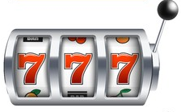
RISKS AND COSTS
When the mixing process fails, the system should be redesigned. In most of the cases the old one could not be modified and a new one should be built.
Acceptance of this scenario leads the project to a high risk and could involve extremely high costs.
The wide range of existing substances, having different physical and chemical properties, combined with different tank and mixers design, leads to practically an infinity possibilities of mixing situations.
CFD SIMULATIONS
FOR TANK MIXING PROCESS

Slide 5


Computational Fluid Dynamics (CFD) Role
Computational Fluid Dynamics (CFD) simulations could help us to reduce the mixing failures by predicting the values of the mixing parameters: pressure and velocity fields, substances volume/mass fractions, shear stress, temperatures, etc.
CFD SIMULATIONS
MIXING
FOR TANK MIXING PROCESS
PASS
FAIL

Slide 6
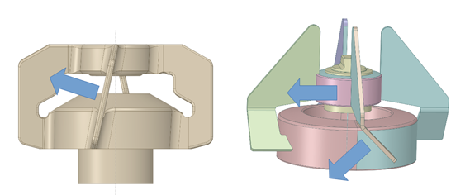
What can we do with CFD?
By using CFD simulations, we can:
Assist the designing of a tank by:
  Choosing of the best solution from different existing designs
  Recommending design modifications for better results
Choose the proper mixer/homogenizer for the application
CFD SIMULATIONS
FOR TANK MIXING PROCESS

Slide 7
What can we do with CFD?
Evaluate if the mixing process needs only one mixer or is necessary to add a homogenizer/second mixer.
Find the best position for manholes, inlet ports, etc.
Find the lowest liquid level that assure a good mixing.
Calculate the mixing times necessary to reach the desired homogeneity of volume fraction or temperature.
Evaluate if different drugs could be produced in the same tank, or it is necessary to use different tank designs.
CFD SIMULATIONS
FOR TANK MIXING PROCESS

Slide 8
MIXING LIQUID WITH POWDER
Practically it is not possible to make a perfect homogeneous mix of a liquid with powder.
The homogeneity has an error.
The powder concentration/volume fraction (VF) distribution is depending on the pressure and velocity fields.
It is very important to calculate the distribution of the powder VF in the tank, to evaluate the homogeneity according to the customer’s targeted error.
CFD SIMULATIONS
FOR TANK MIXING PROCESS

Slide 9
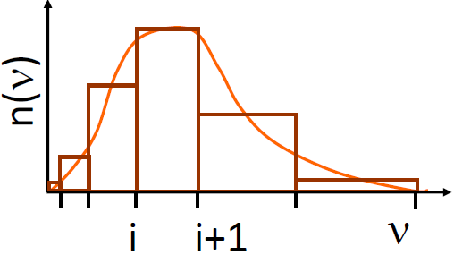
MIXING LIQUID WITH POWDER
In the CFD analysis we can consider a wide range of phenomenon like:
granulation
flocculation
crystallization
dissolution
by using different models for particles aggregation, breakage, nucleation and other physical chemistry models.
We can define different particle size distributions.
CFD SIMULATIONS
FOR TANK MIXING PROCESS

Slide 10
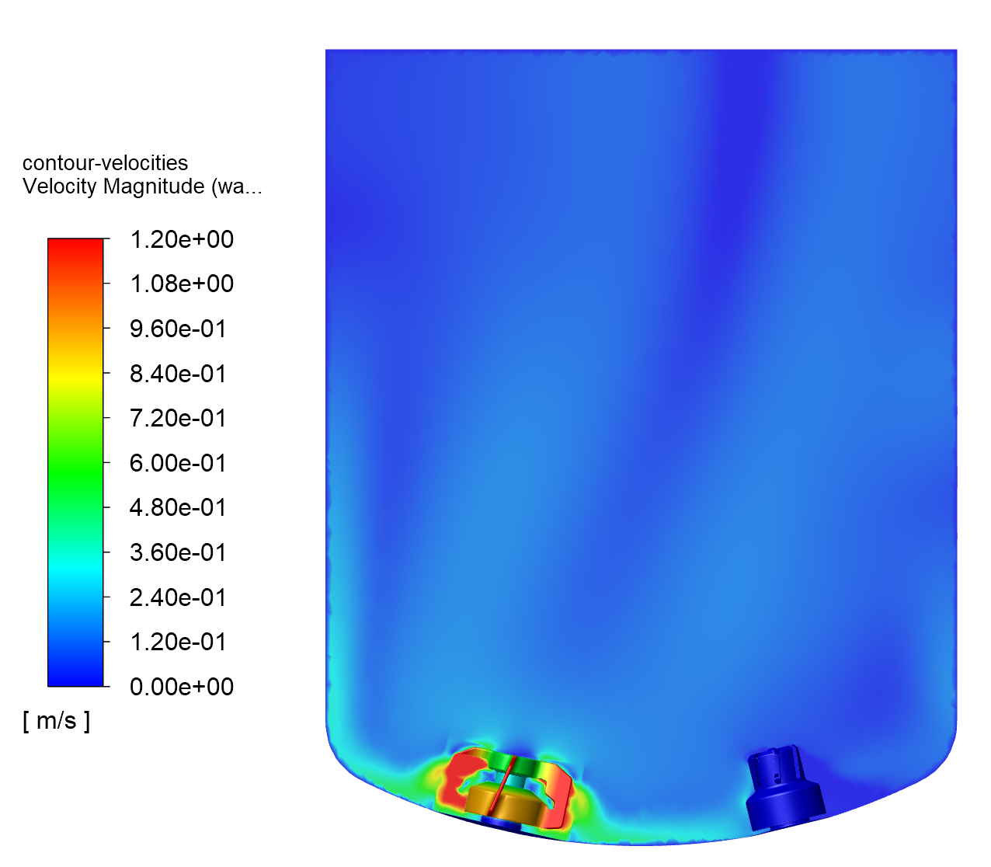
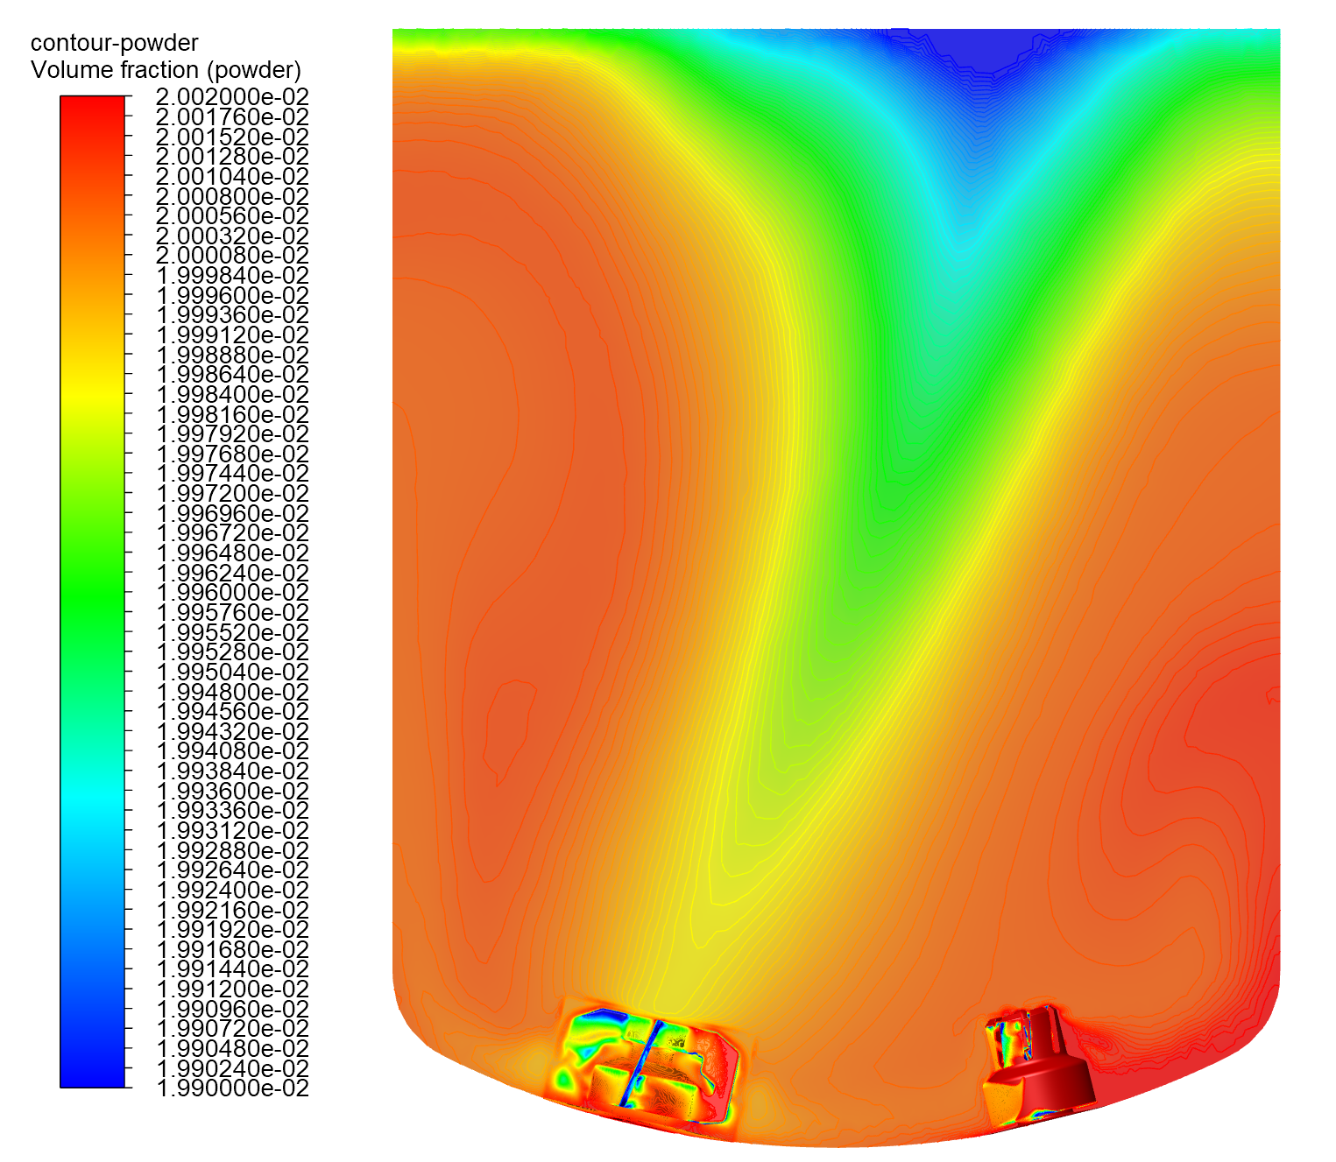
CFD SIMULATIONS
FOR TANK MIXING PROCESS
r_{powder} = 1300 kg/m3, VF_{powder}=0,2%
Mixer: 300 rpm Homogenizer: 0 rpm
ΔVF=0.6%

Slide 11
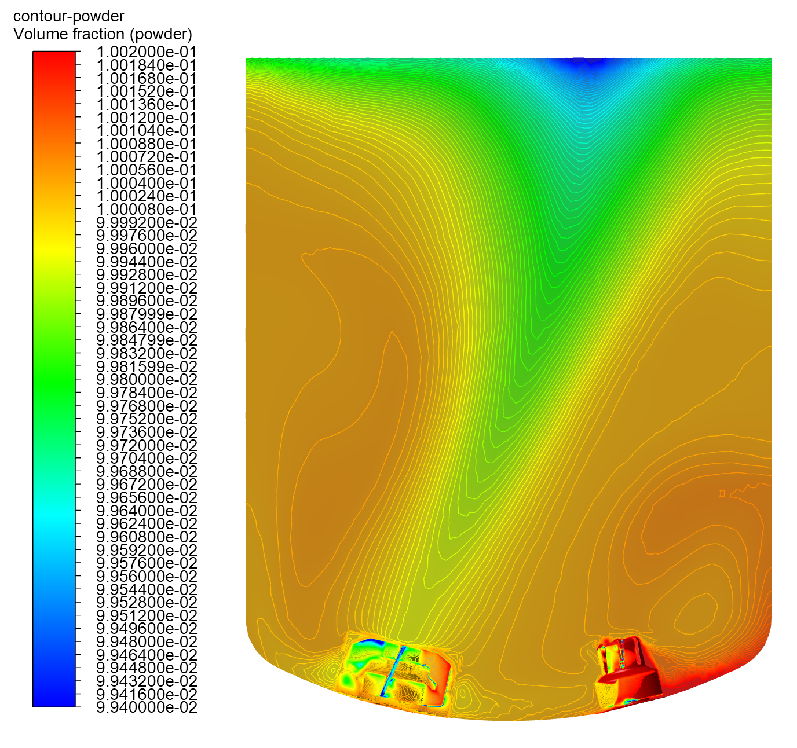
CFD SIMULATIONS
FOR TANK MIXING PROCESS
r_{powder} = 1300 kg/m3, VF_{powder}=1%
Mixer: 300 rpm Homogenizer: 0 rpm
ΔVF=0.8%

Slide 12
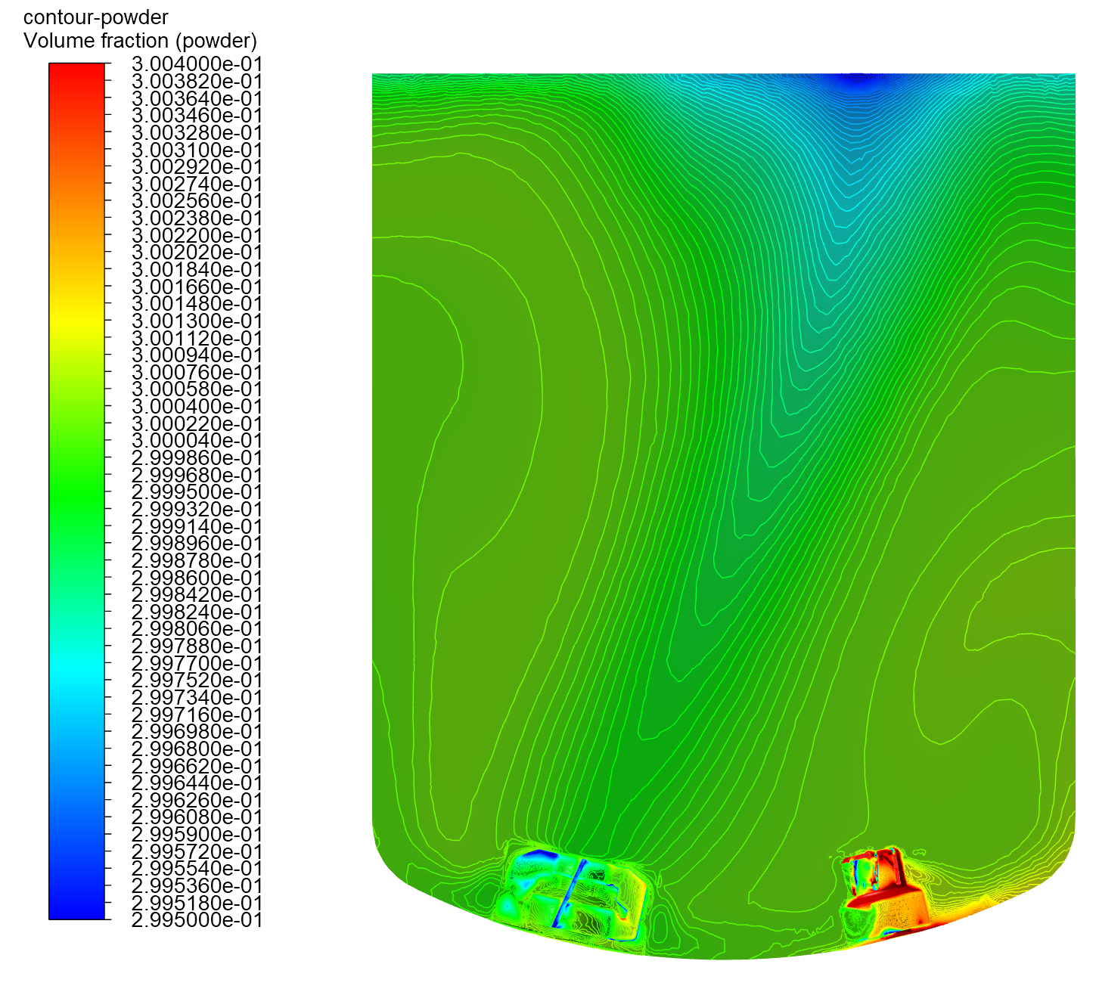
CFD SIMULATIONS
FOR TANK MIXING PROCESS
r_{powder} = 1500 kg/m3, VF_{powder}= 30%
Mixer: 300 rpm Homogenizer: 0 rpm
ΔVF=0.3%

Slide 13
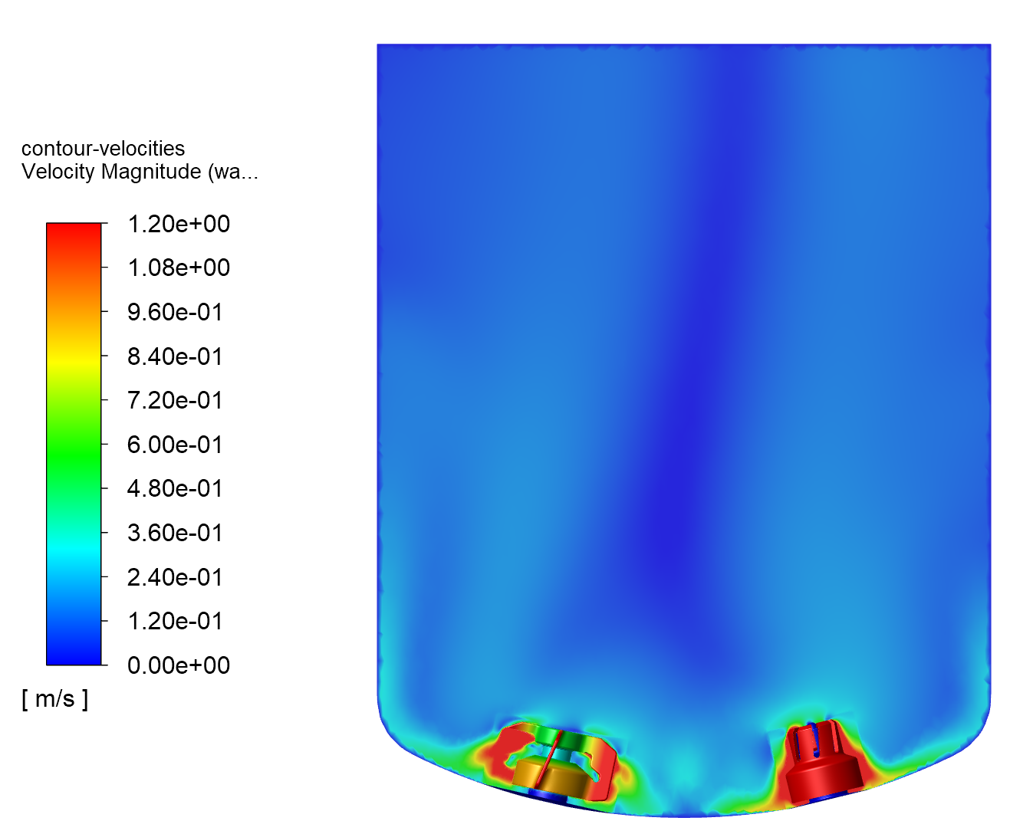
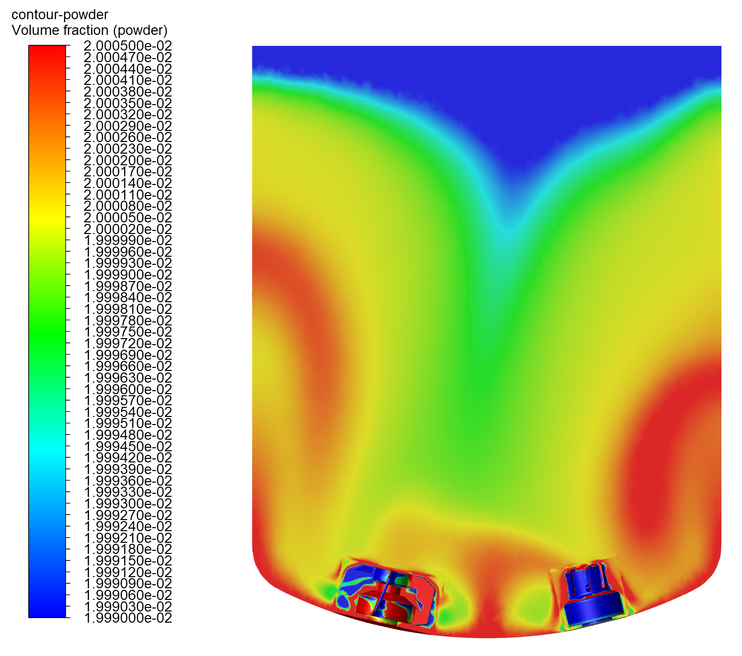
CFD SIMULATIONS
FOR TANK MIXING PROCESS
r_{powder} = 1300 kg/m3, VF_{powder}=0,2%
Mixer: 300 rpm Homogenizer: 2000 rpm
ΔVF=0.075%

Slide 14
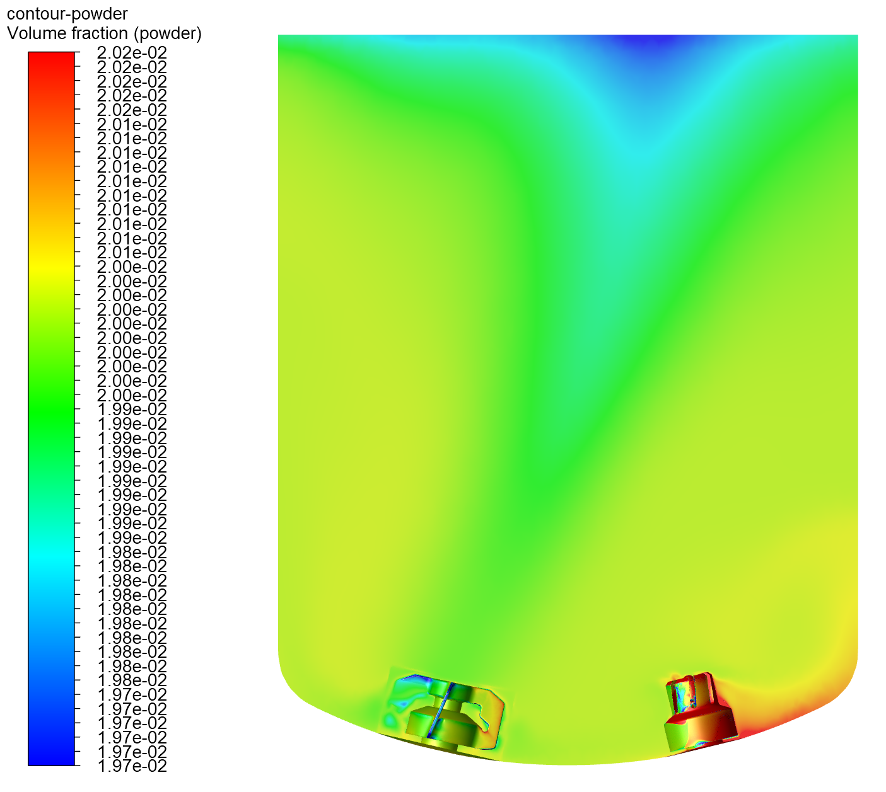
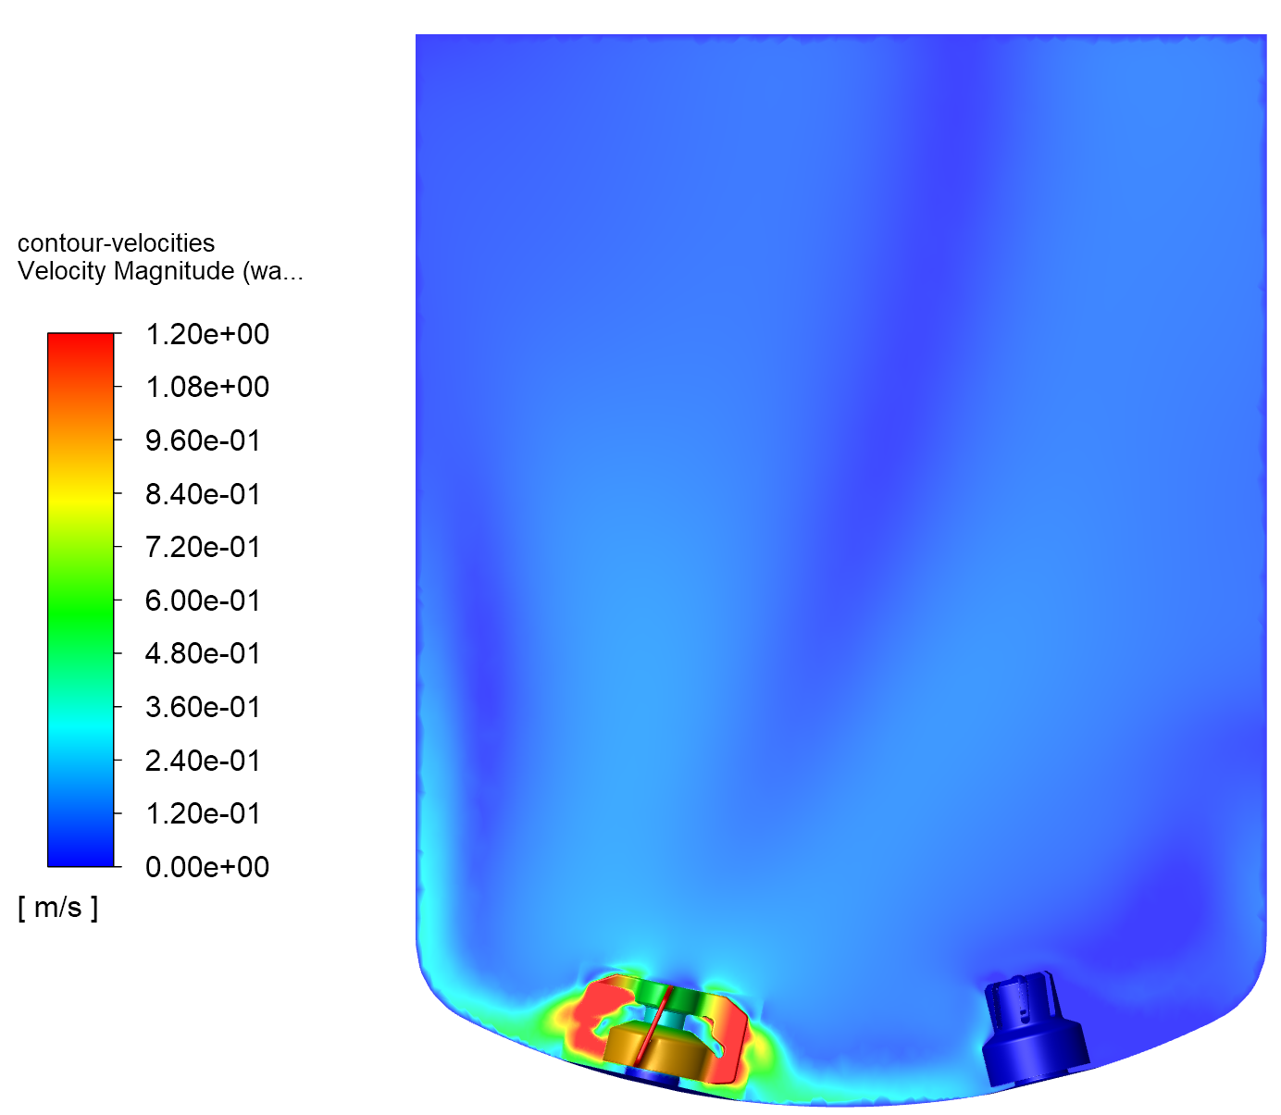
CFD SIMULATIONS
FOR TANK MIXING PROCESS
r_{powder} = 1700 kg/m3, VF_{powder}=1%
Mixer: 300 rpm Homogenizer: 0 rpm
ΔVF=2.5%

Slide 15
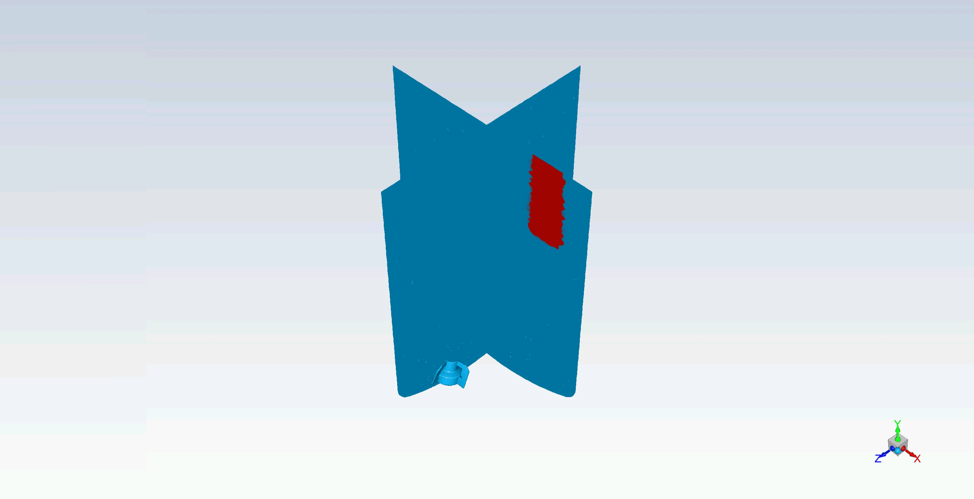
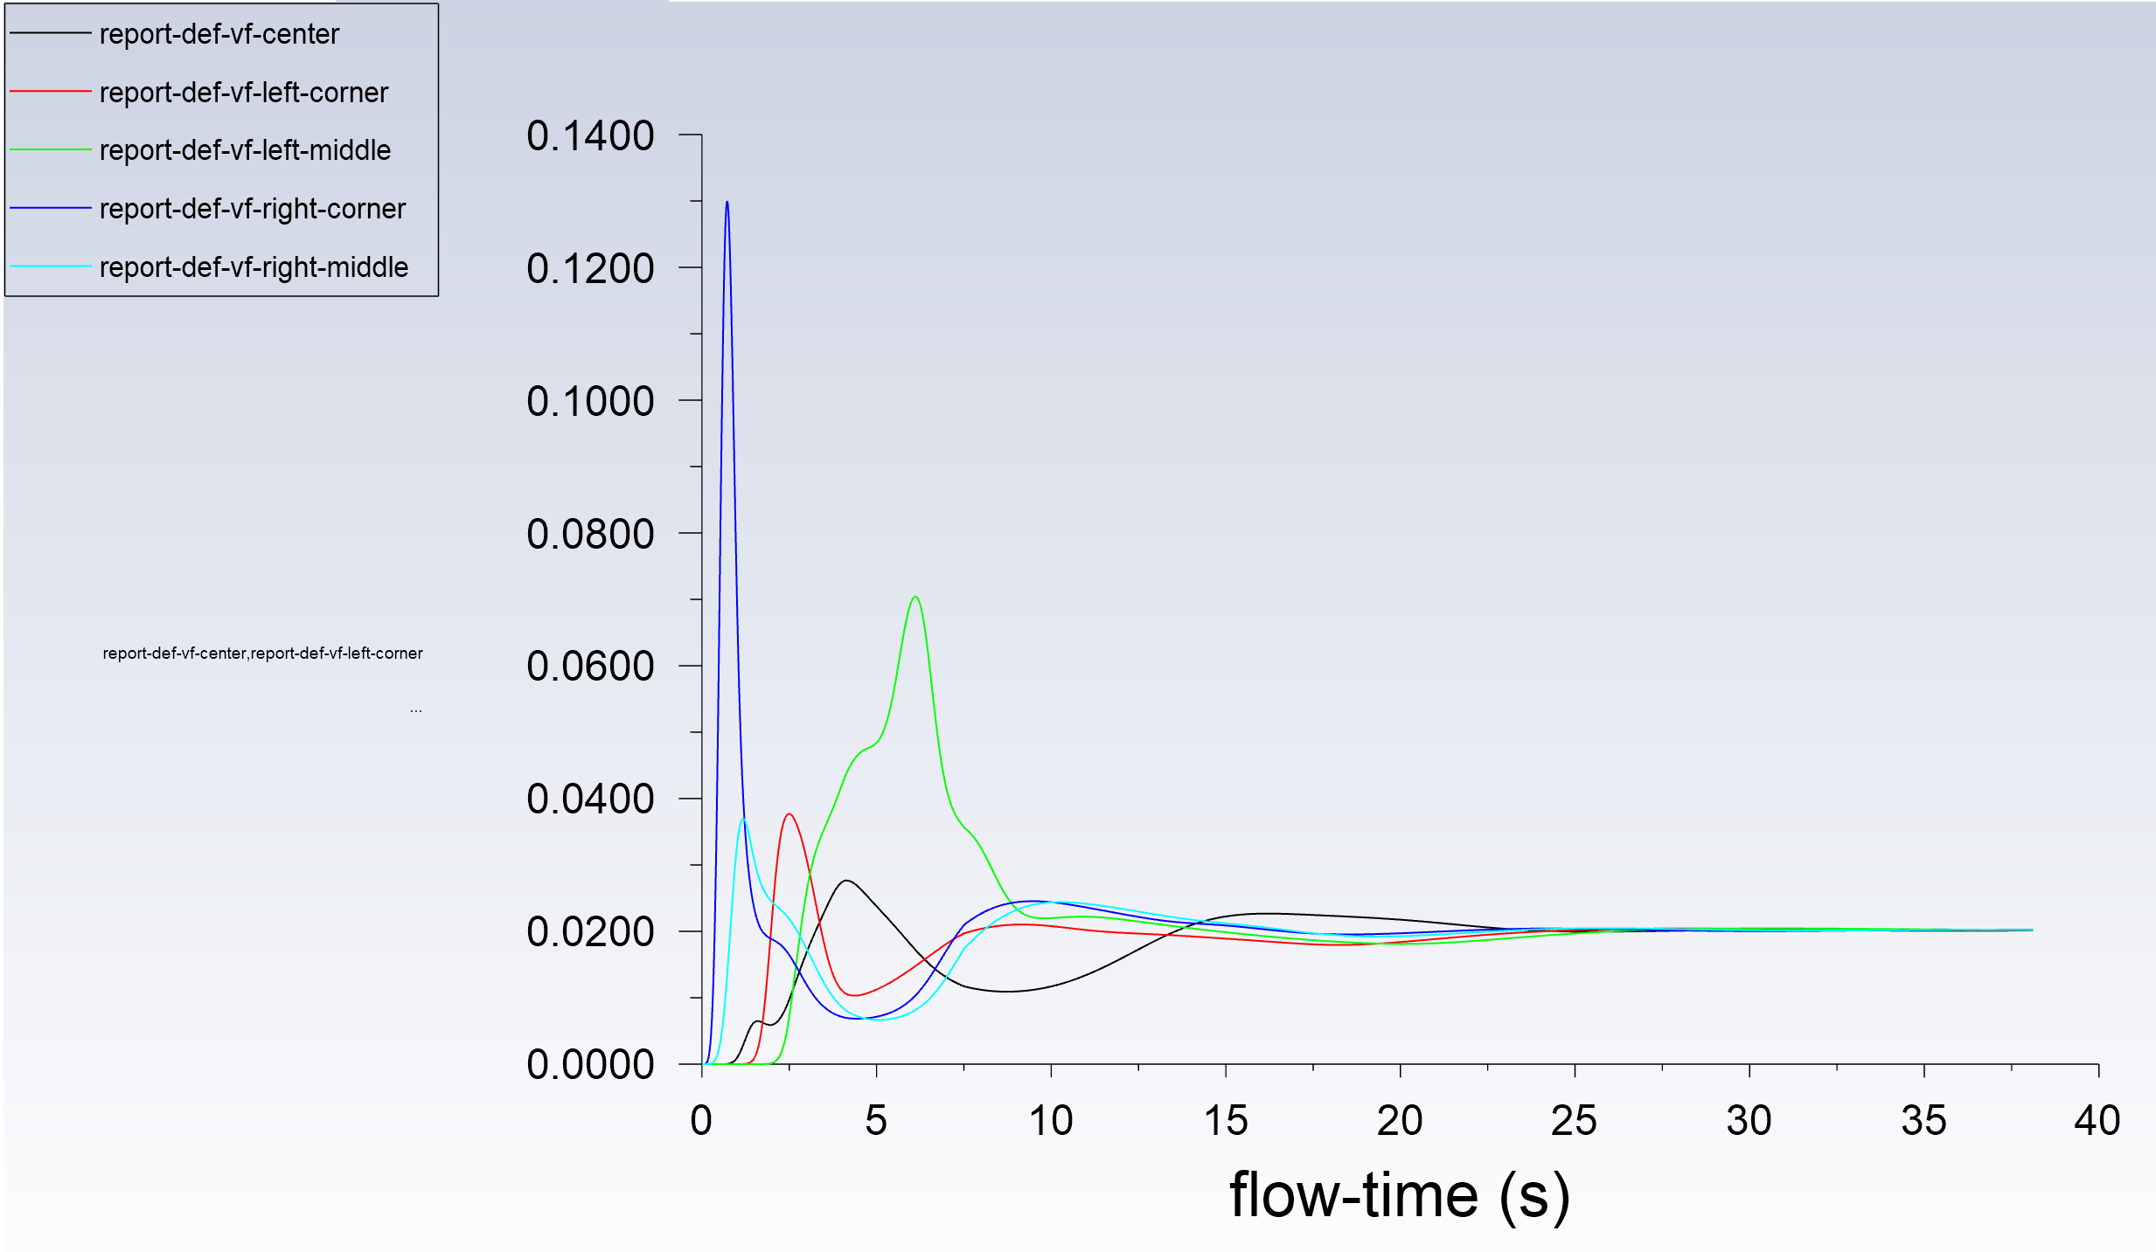
MIXING LIQUID WITH POWDER
We can calculate the time needed to achieve the desired homogeneity.
CFD SIMULATIONS
FOR TANK MIXING PROCESS

Slide 16
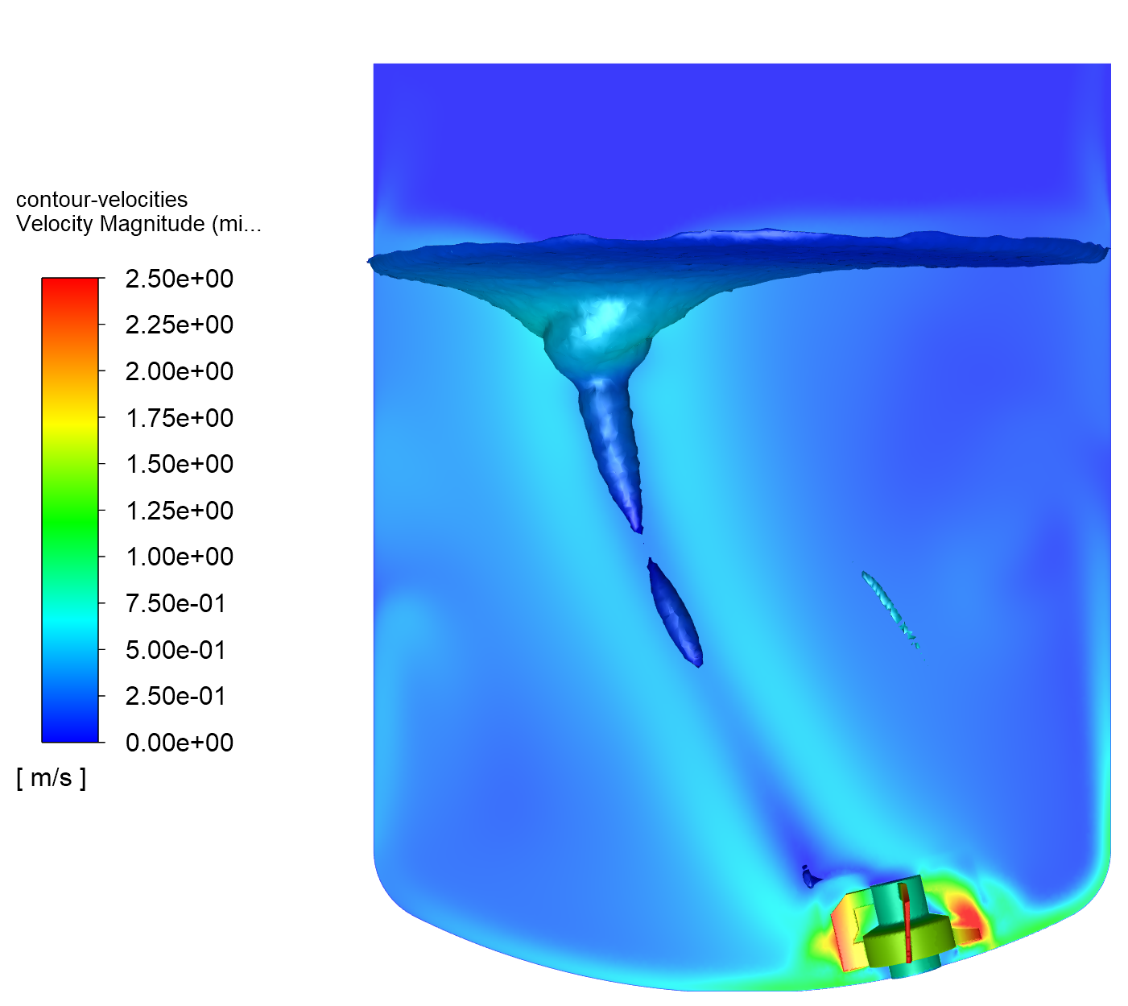
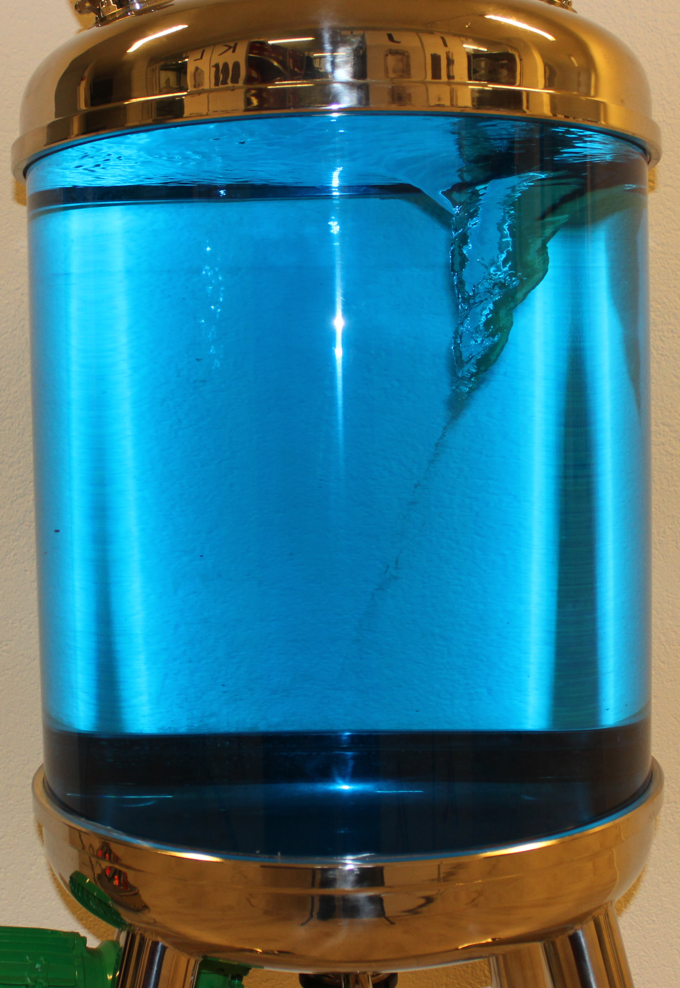
MIXING LIQUID WITH ANOTHER FLUID
We can perform studies for:
Liquid with liquid (miscible or immiscible)
Liquid with gas (e.g. sparging)
Newtonian and non-newtonian liquids
CFD SIMULATIONS
FOR TANK MIXING PROCESS

Slide 17
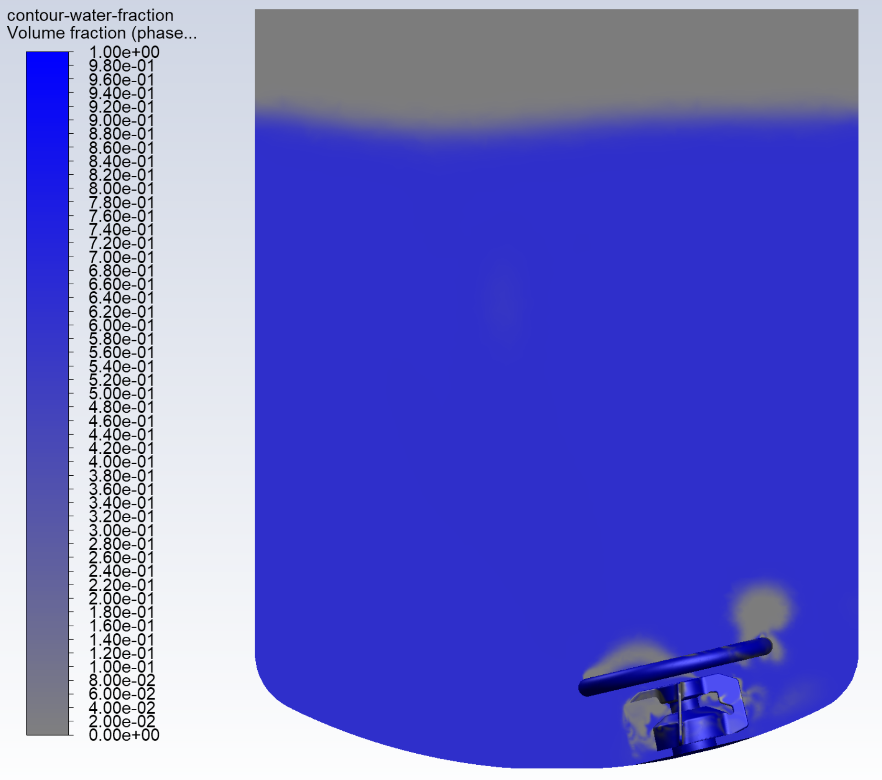
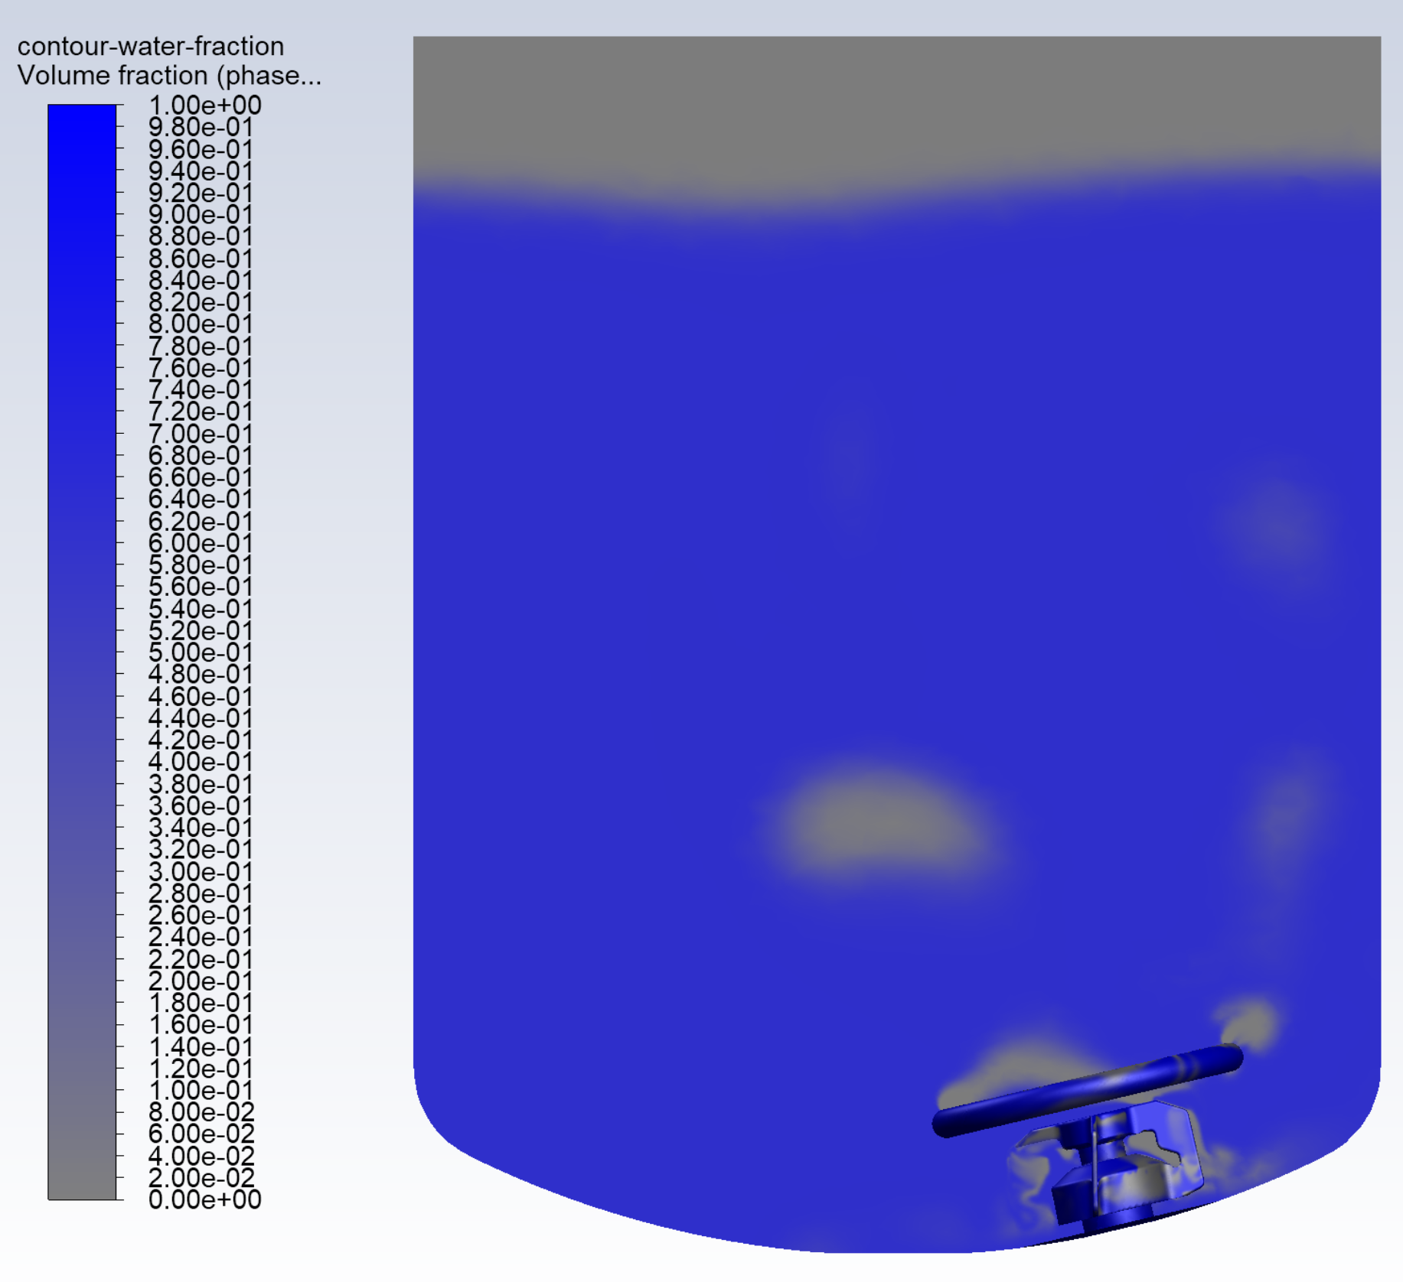
MIXING LIQUID WITH ANOTHER FLUID
In the CFD analysis we can consider a wide range of phenomenon like:
Gas diffusion in the liquids
Chemical reactions
Water/steam evaporation/condensation
CFD SIMULATIONS
FOR TANK MIXING PROCESS

Slide 18
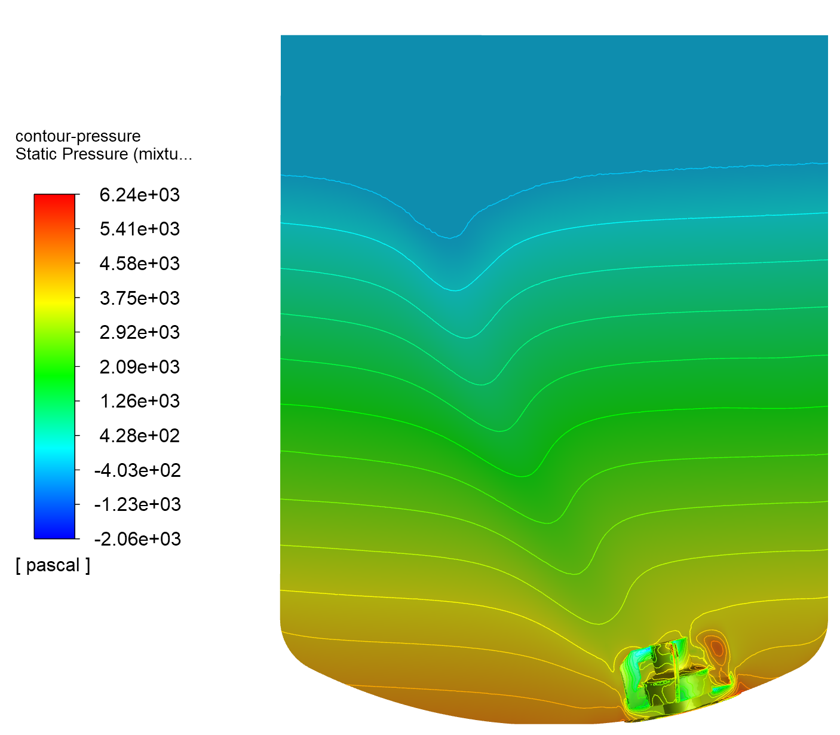
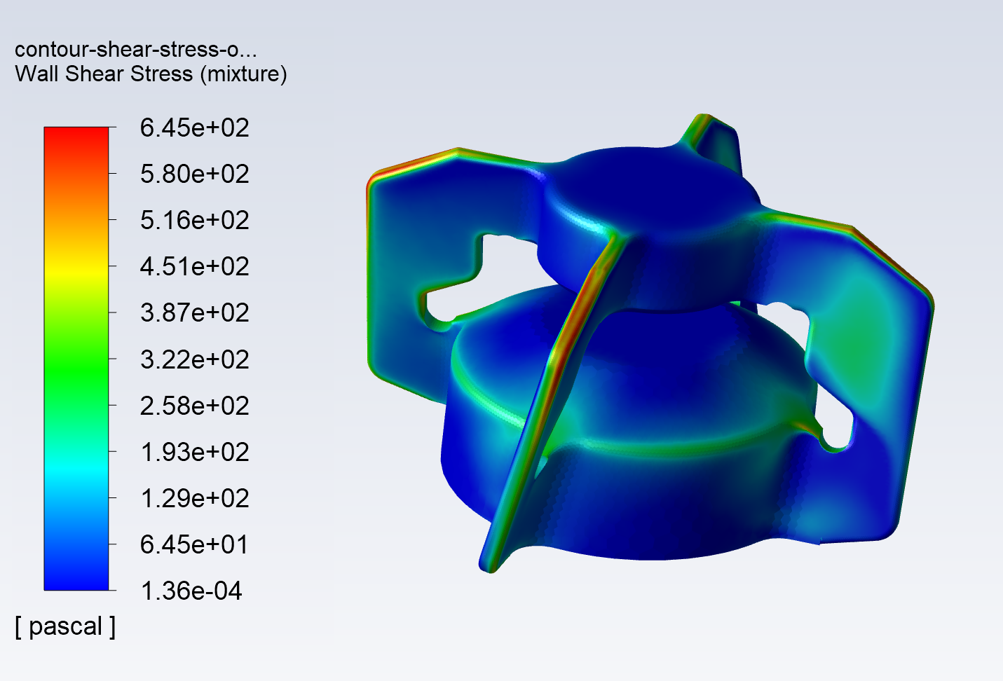
MIXING LIQUID WITH ANOTHER FLUID
We can calculate all the parameters:
Velocities & pressures
Shear stress
Volume fractions / concentrations
CFD SIMULATIONS
FOR TANK MIXING PROCESS

Slide 19
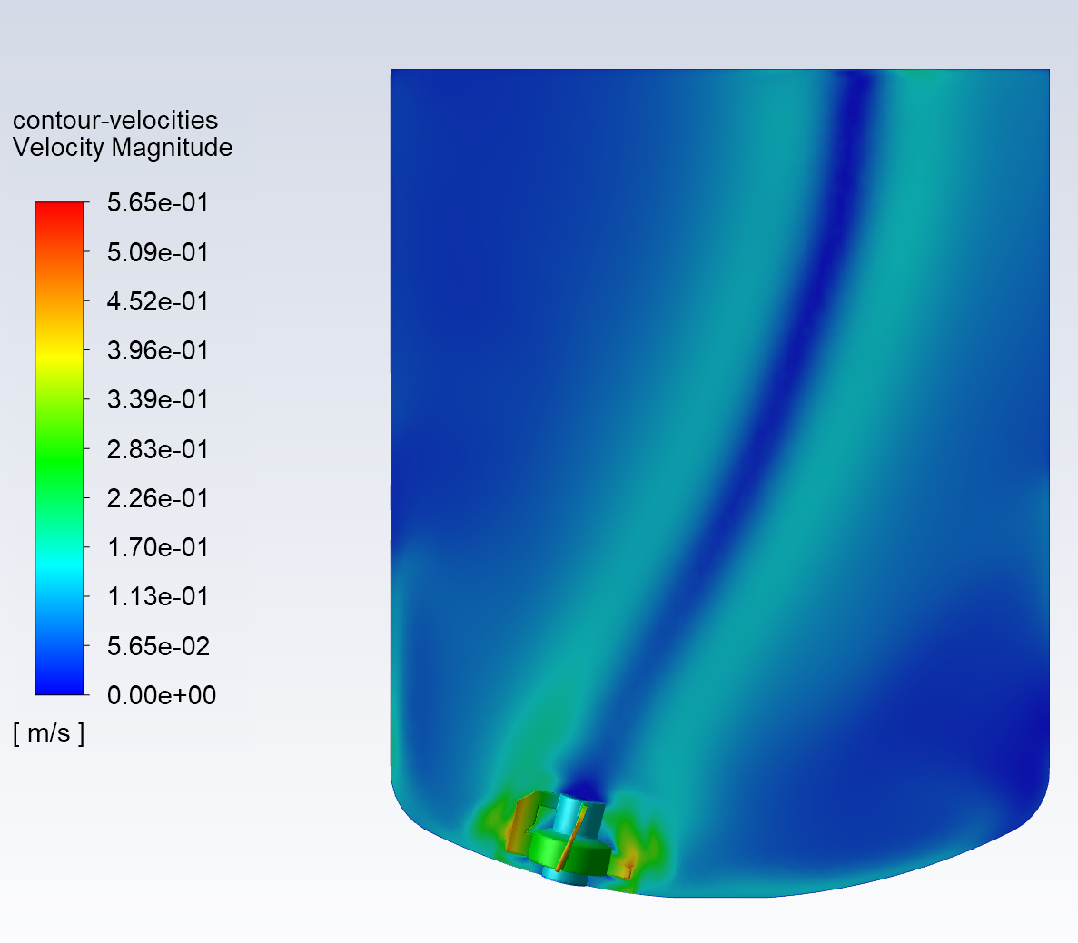
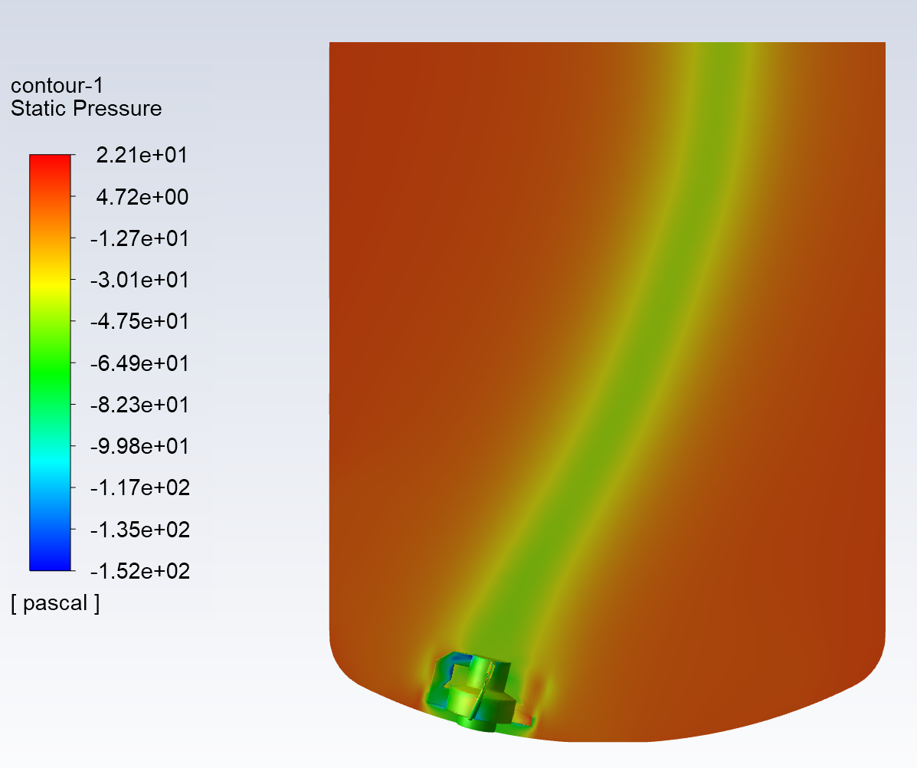
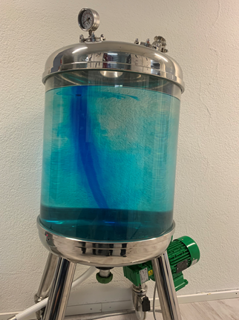
CFD SIMULATIONS
FOR TANK MIXING PROCESS
Experimental confirmation of the CFD predictions

