Slide 1
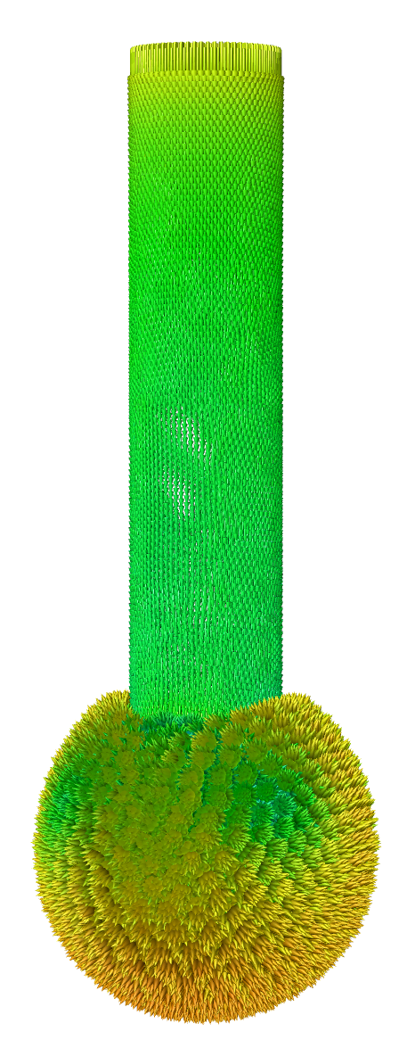
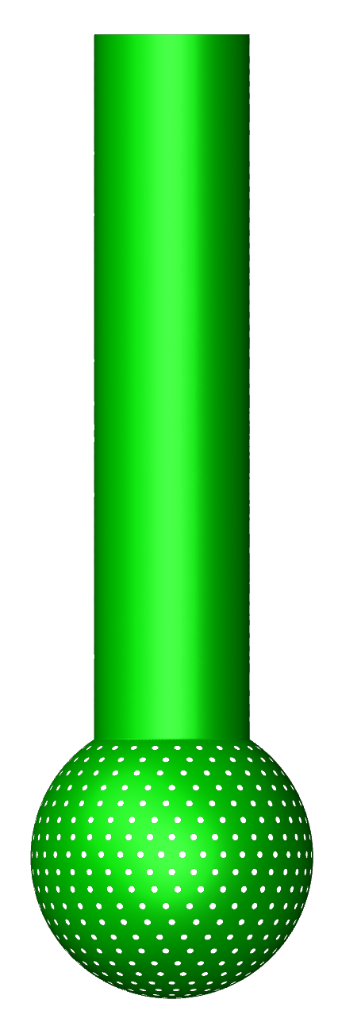
CFD SIMULATIONS
FOR SPRAY BALLS

Slide 2
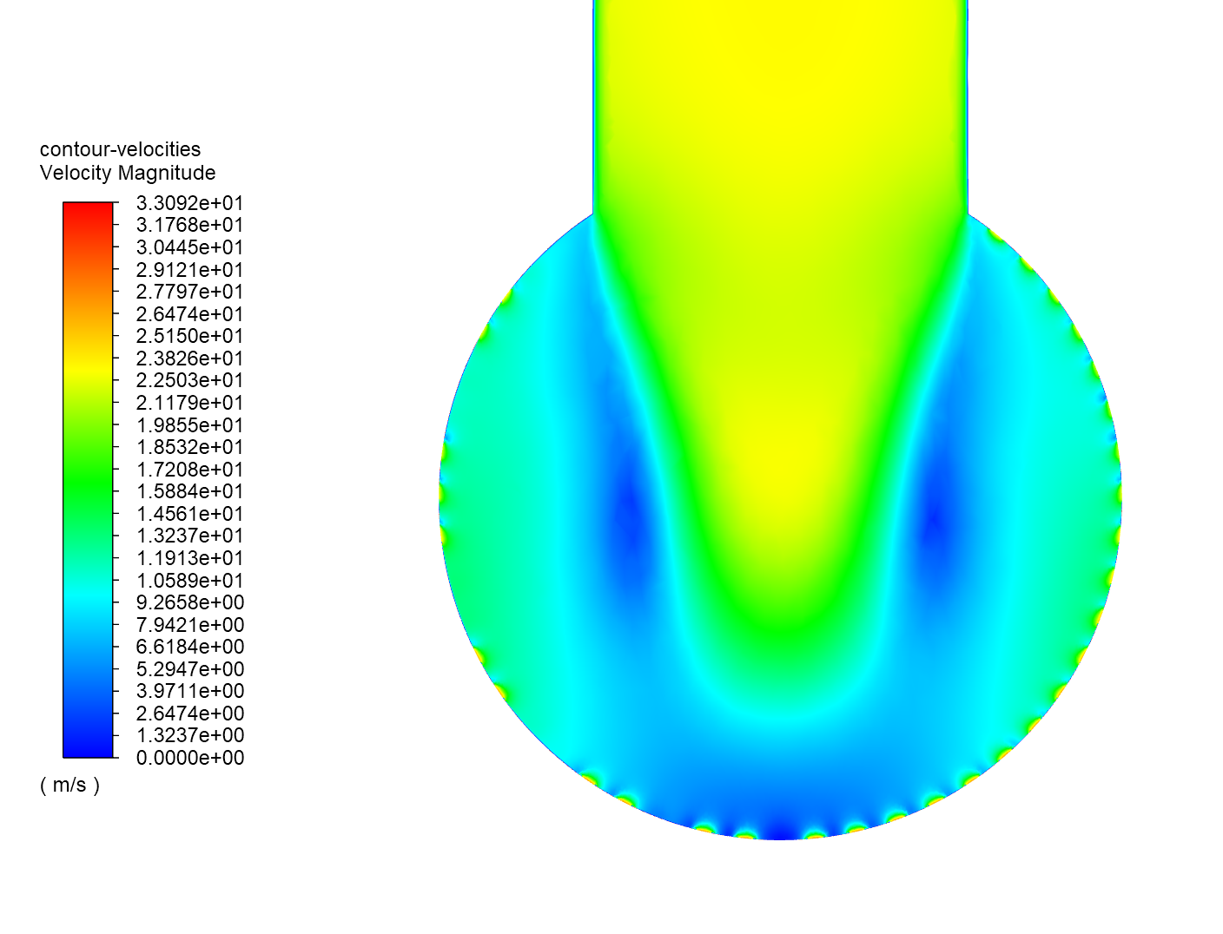
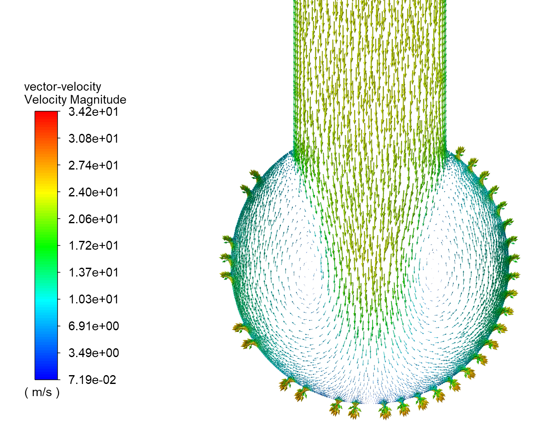
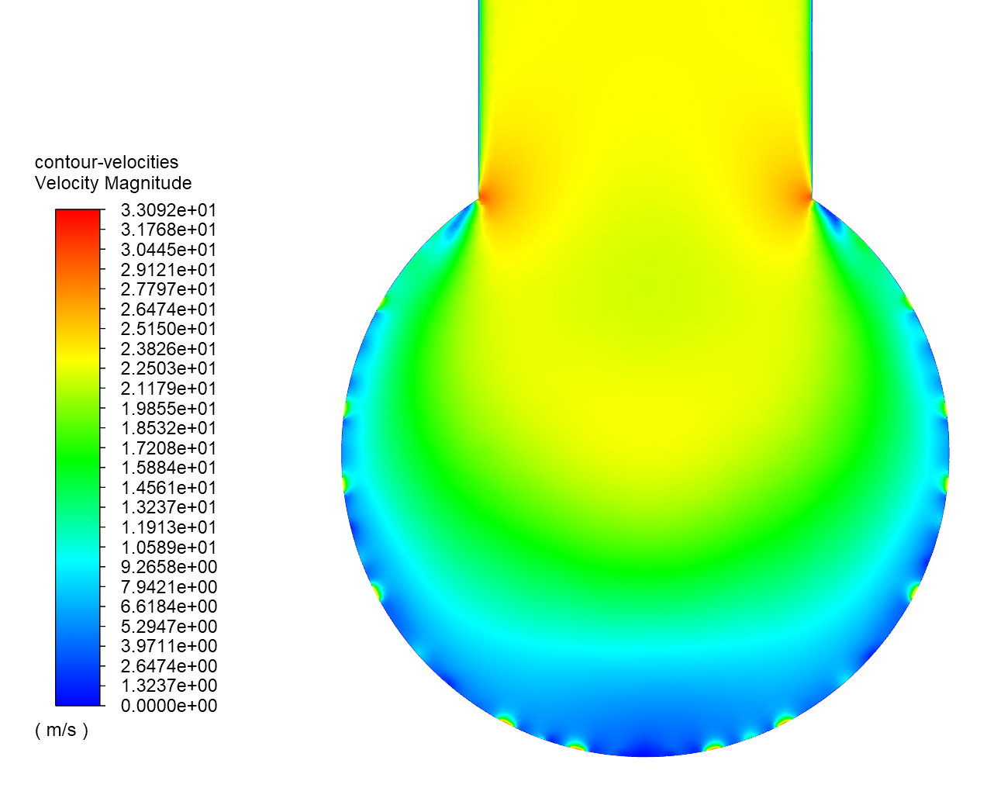
INTRODUCTION
CFD simulations could lead to big improvements of the spray balls design and to calculate the Kv/Cv(flow coefficients) before/after production, without measuring.
CFD SIMULATIONS
FOR SPRAY BALLS

Slide 3
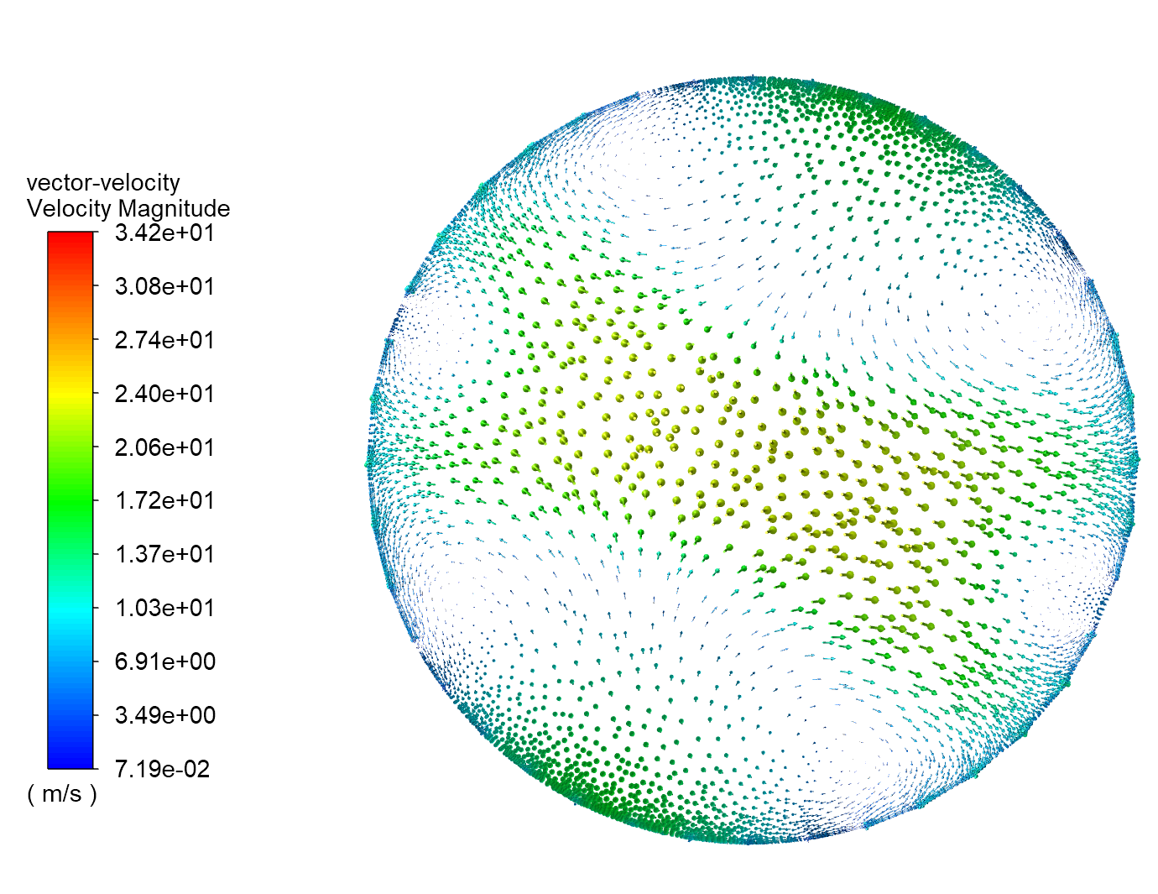
FLOW PROFILES INFLUENCE THE CLEANING EFFICIENCY
The patterns of the outlet holes creates different flow profiles inside the spray ball.
CFD SIMULATIONS
FOR SPRAY BALLS

Slide 4
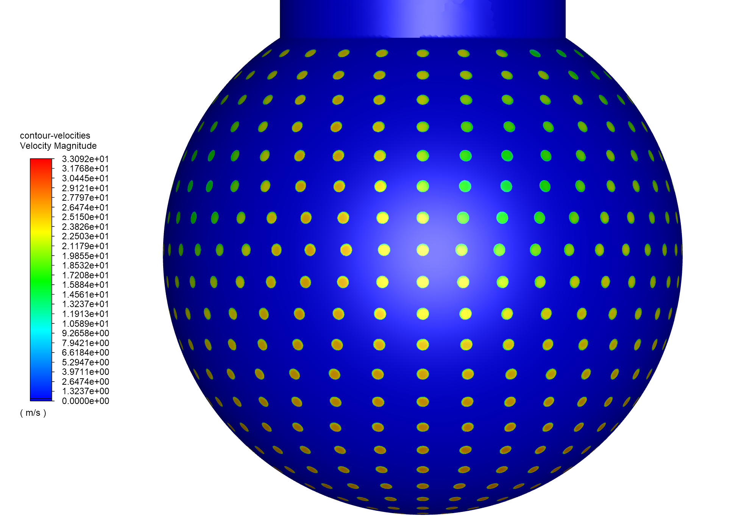
FLOW PROFILES INFLUENCE THE CLEANING EFFICIENCY
For some patterns could appear big differences of the outlet velocity between the holes, leading to CIP problems.
CFD SIMULATIONS
15 m/s
FOR SPRAY BALLS
27 m/s

Slide 5
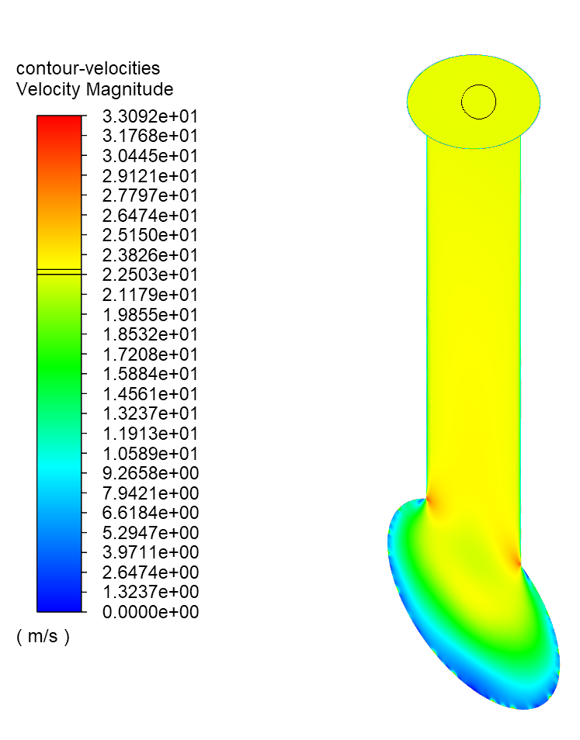
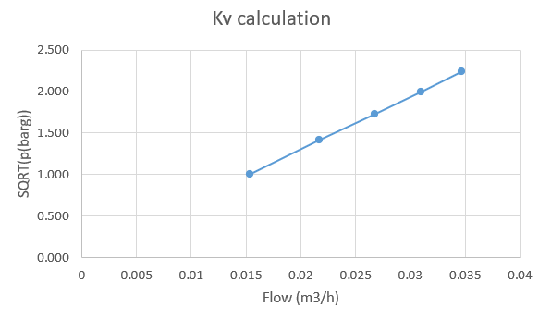
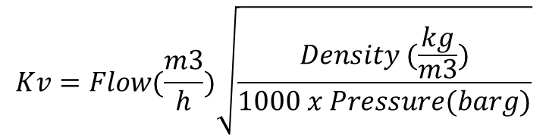
Kv (flow coefficient) calculation
We are simulating the flow through the spray ball at different differential pressures and we are obtaining the inlet flow. Kv coefficient is basically calculated from the formula:
CFD SIMULATIONS
$$Kv=Flow(\frac{m3}{h})\sqrt{\frac{Density (\frac{kg}{m3})}{1000 x Pressure(barg)}}$$
FOR SPRAY BALLS
Linear dependency between the flow and Δp

