Slide 1
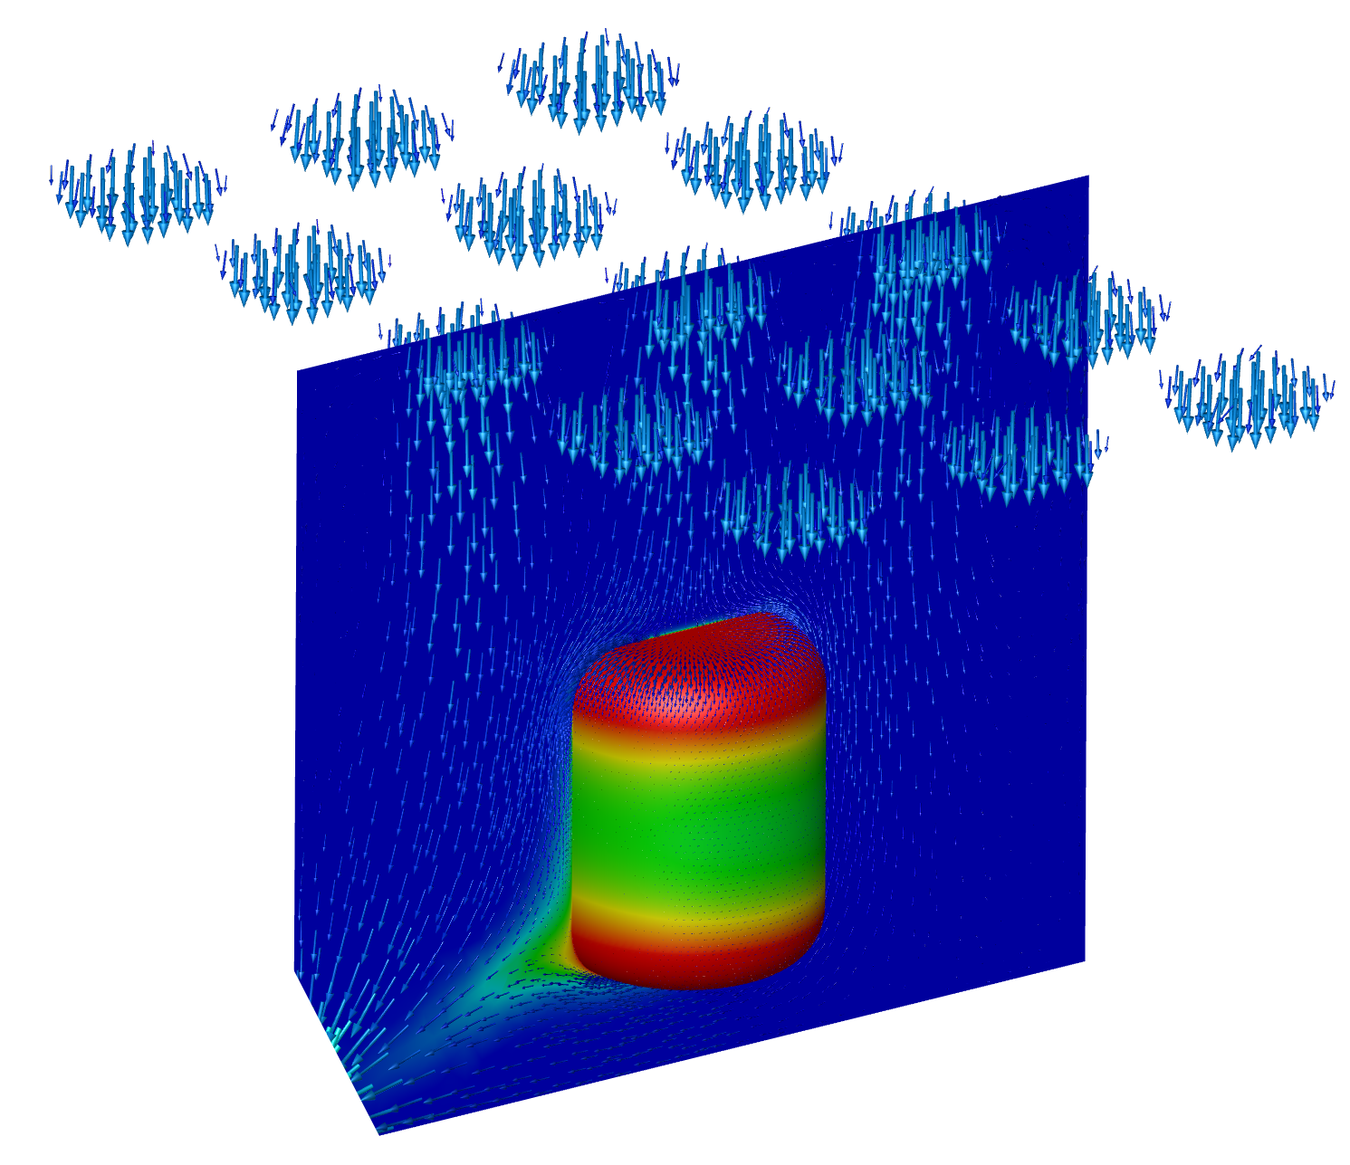
CFD SIMULATIONS
FOR STERILIZATION PROCESS

Slide 2
INTRODUCTION
One of the big challenges when you want:
to design a CS (clean steam) distribution system
to calculate the CS generator capacity
to configure a pressure regulator for a CS user point
is to evaluate the CS consumptions of the systems. Without having correct data, everything could go in wrong directions like:
to have an over-dimensioned CS generator, that will consume a lot of unnecessary energy
to have a pressure regulator that is not working properly, by having an outlet pressure bigger than the setpoint, and acting as a rudimentary on/off valve destroying frequently the valve seat.
CFD SIMULATIONS
FOR STERILIZATION PROCESS

Slide 3
INTRODUCTION
A big mistake in most of the cases is to consider the system CS consumptions during the sterilization, to be the CS consumption given by the system producer. In most of the cases, this value is the maximum reached during the factory tests when the system is vacuumed, and the CS is penetrating the system.
The value given by the system producer could be 100x or 10x greater than the real one during the sterilization process.
CFD SIMULATIONS
FOR STERILIZATION PROCESS

Slide 4
INTRODUCTION
Aseptconn offers to you Computational Fluid Dynamics (CFD) simulations services for the evaluation of the CS consumptions.
In the next slides we will present to you a case study for a 1000 liters tank.
CFD SIMULATIONS
FOR STERILIZATION PROCESS

Slide 5
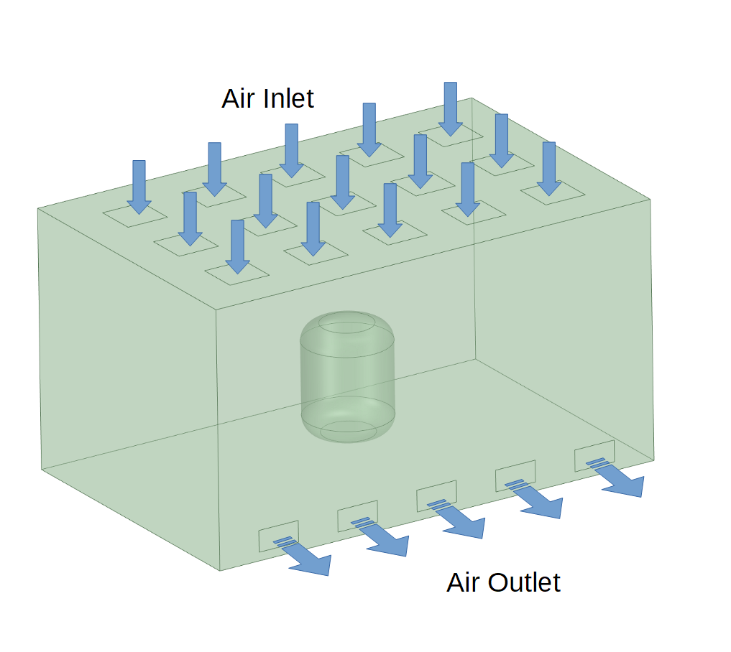
CASE STUDY – 1000 liters tank
We have considered a 1000 liters tank, placed into a clean room of 4.5 x 3.5 x 3 meters (L x W x H). The air is coming in with 20ºC. The sterilization is done with steam at 121ºC. The tank is jacketed in the middle region.
CFD SIMULATIONS
For this kind of tanks, the system producers could specify the CS consumption to be in the range 50÷100 kg/h !!!
FOR STERILIZATION PROCESS

Slide 6
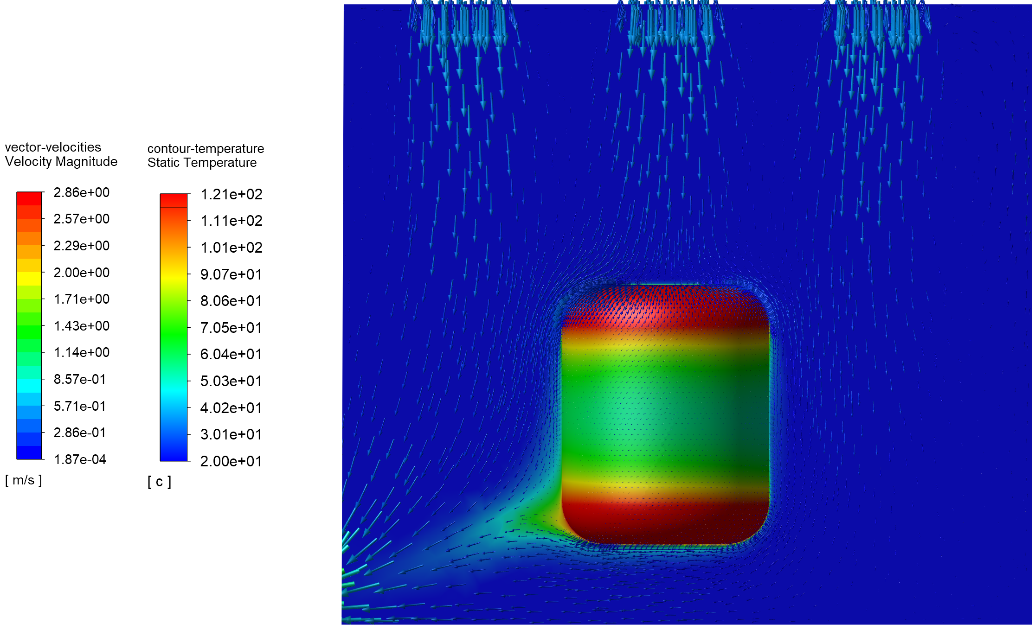
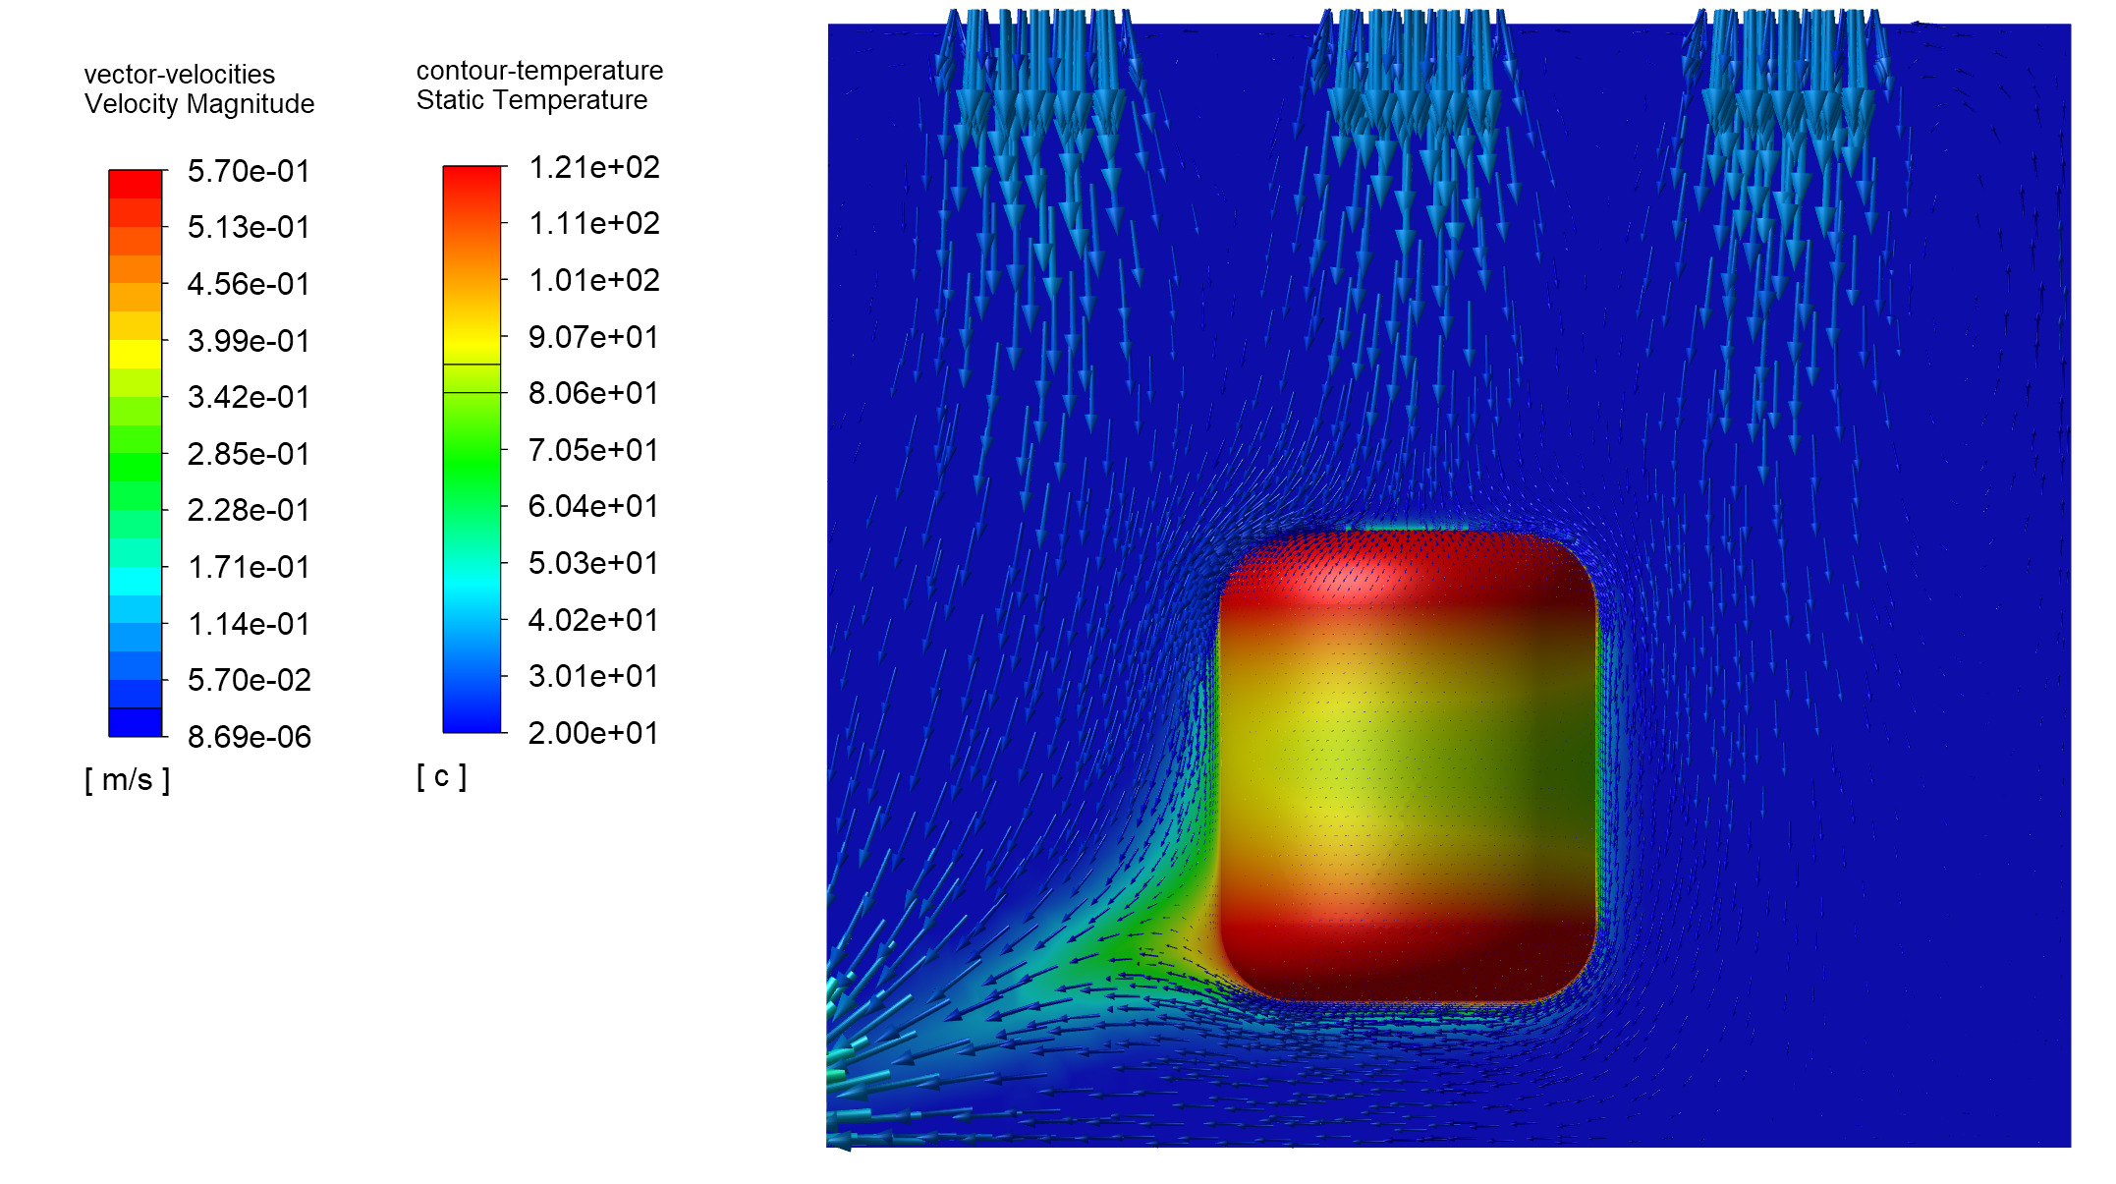
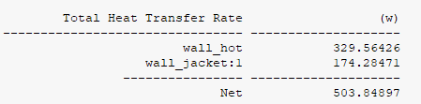
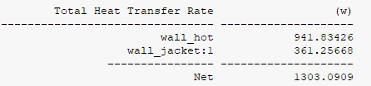
CFD SIMULATIONS
FOR STERILIZATION PROCESS
Calcualtion of the CS consumption during sterilization process, for 1000 liters vessel:
Steam consumption
during sterilization:
2.13 kg/h
Steam consumption
during sterilization:
0.82 kg/h
Air inlet velocity: 0.5 m/s
Air inlet velocity: 0.1 m/s

Slide 7
CONCLUSIONS
It is very important to evaluate the CS consumptions during the sterilization phase. In most of the cases the values indicated by the producer could be 100x greater.
The consumptions are depending on a lot of parameters. With CFD simulations we can do very good evaluations for different conditions.
CFD SIMULATIONS
100X DIFFERENCE
REALLY COUNTS FOR YOUR PROJECT !!!
FOR STERILIZATION PROCESS

